Slide 1

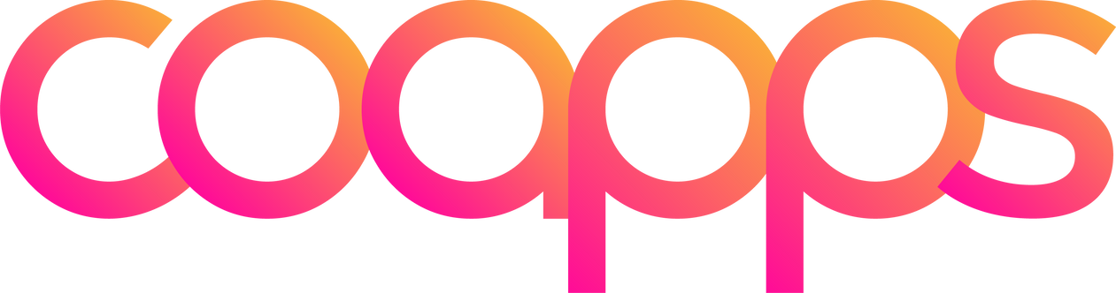

HUMAN RESOURCE
MANAGEMENT
Presented by: Team Envision
Tharunaditya Anuganti
Karthik Reddy Nallamilli
Sandeep Goud A
Nandu Goud Kalimera

Slide 2

OVERVIEW
01
02
03
Introduction
Objectives
Technologies
05
06
06
Features and Functionalities
Features and Functionalities
Conclusion

Slide 3

INTRODUCTION
The HRMS is a comprehensive web-based application designed to streamline and automate HR processes, addressing the critical needs of efficient human resource management. It manages employee information, attendance, payroll, recruitment, and leaves, reducing the administrative burden on HR staff. This allows HR to focus on strategic activities, enhancing employee engagement and organizational performance. By integrating various HR functions into one platform, the HRMS ensures data consistency, improves efficiency, and provides valuable insights through analytics and reporting.
Key features:
Employee information management
Attendance tracking
Payroll processing
Recruitment handling
Leave management

Slide 4
HRMS Objectives
Accessibility
The HRMS is designed to achieve several key objectives:
Ensure HR data is easily accessible to authorized personnel, enhancing transparency and decision-making.
Efficiency
Compliance
User-Friendliness
Automate routine HR tasks, allowing HR professionals to focus on strategic initiatives.
Maintain accurate records and automate compliance checks to help organizations adhere to labor laws and regulations.
Offer an intuitive interface that is easy for employees, managers, and HR professionals to navigate and use.
Accuracy
Scalability
Reduce errors through consistent and reliable data management
Provide a solution that grows with the organization, accommodating increasing data and users.

Slide 5


TECHNOLOGIES USED IN HRMS
FRONTEND TECHNOLOGIES:
BACKEND TECHNOLOGIES:
HTML (HyperText Markup Language): Structures the content of the web application, defining elements like headings, paragraphs, forms, buttons, and links.
CSS (Cascading Style Sheets): Styles the HTML content, controlling layout, colors, fonts, and ensuring responsiveness across devices.
JavaScript: Adds interactivity and dynamic behavior, enabling real-time updates, form validations, interactive charts, and responsive UIs. Frameworks like React or Vue.js can enhance frontend interactions.
Python: The primary language for backend development, handling server-side logic, data processing, and integration.
Django: A high-level Python web framework following the MVC architecture, providing features for user authentication, form processing, and database migrations. Django’s ORM facilitates secure and scalable database interactions.

Slide 6
TECHNOLOGIES USED IN HRMS
ADDITIONAL TOOLS AND TECHNOLOGIES
DATABASE
MySQL: A relational database management system used to store and manage data, supporting complex queries, transactions, and data integrity. It handles employee information, attendance, leave balances, payroll data, and more.
Git: A version control system for tracking code changes, enabling collaboration among developers and maintaining a history of code modifications. Repositories like GitHub or GitLab host the code and facilitate teamwork.
Virtual Environment (venv): Creates isolated Python environments, managing project-specific dependencies and preventing conflicts with other projects.

Slide 7

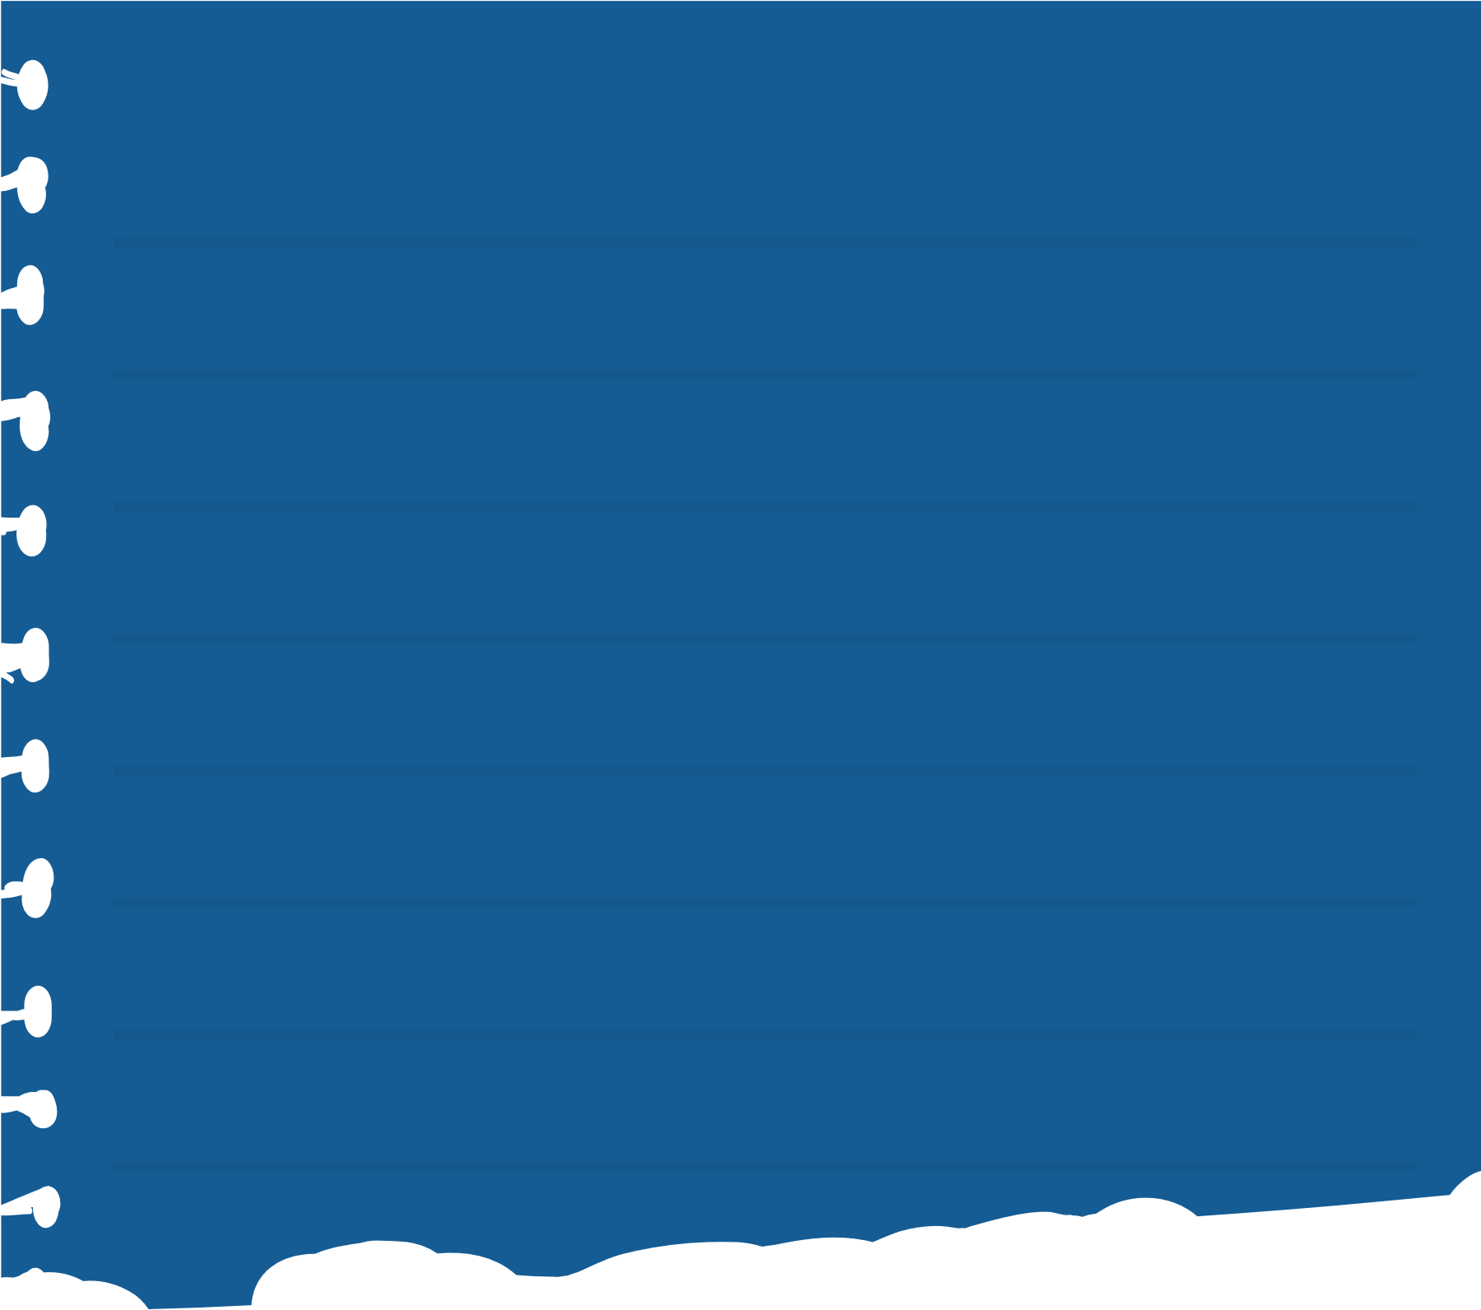


FEATURES AND FUNCTIONALITIES
Employee Management
Onboarding and Offboarding
Recruitment Management
Centralized employee profiles for personal and job details.
Self-update options and document management
Automated workflows for seamless transitions.
Exit processes and final payroll management.
Job postings and applicant tracking.
Interview scheduling and feedback collection.

Slide 8
FEATURES AND FUNCTIONALITIES
Attendance Tracking
Leave Management
Payroll Management
Daily logging and leave management.
Customizable reports and notifications.
Online leave requests and real-time balances.
Detailed reports and trend analysis.
Automated salary calculation and tax compliance.
Electronic payslips and statutory deductions.

Slide 9


Conclusion
The Human Resources Management System (HRMS) represents a significant advancement in the way organizations manage their human resources. By integrating various HR functions into a single, cohesive platform, the HRMS addresses many of the challenges faced by HR departments today, such as data fragmentation, manual processes, and lack of real-time insights. This system not only improves operational efficiency but also enhances the overall employee experience, contributing to a more engaged and productive workforce.

Slide 10













THANK YOU VERY MUCH!

